Slide 1
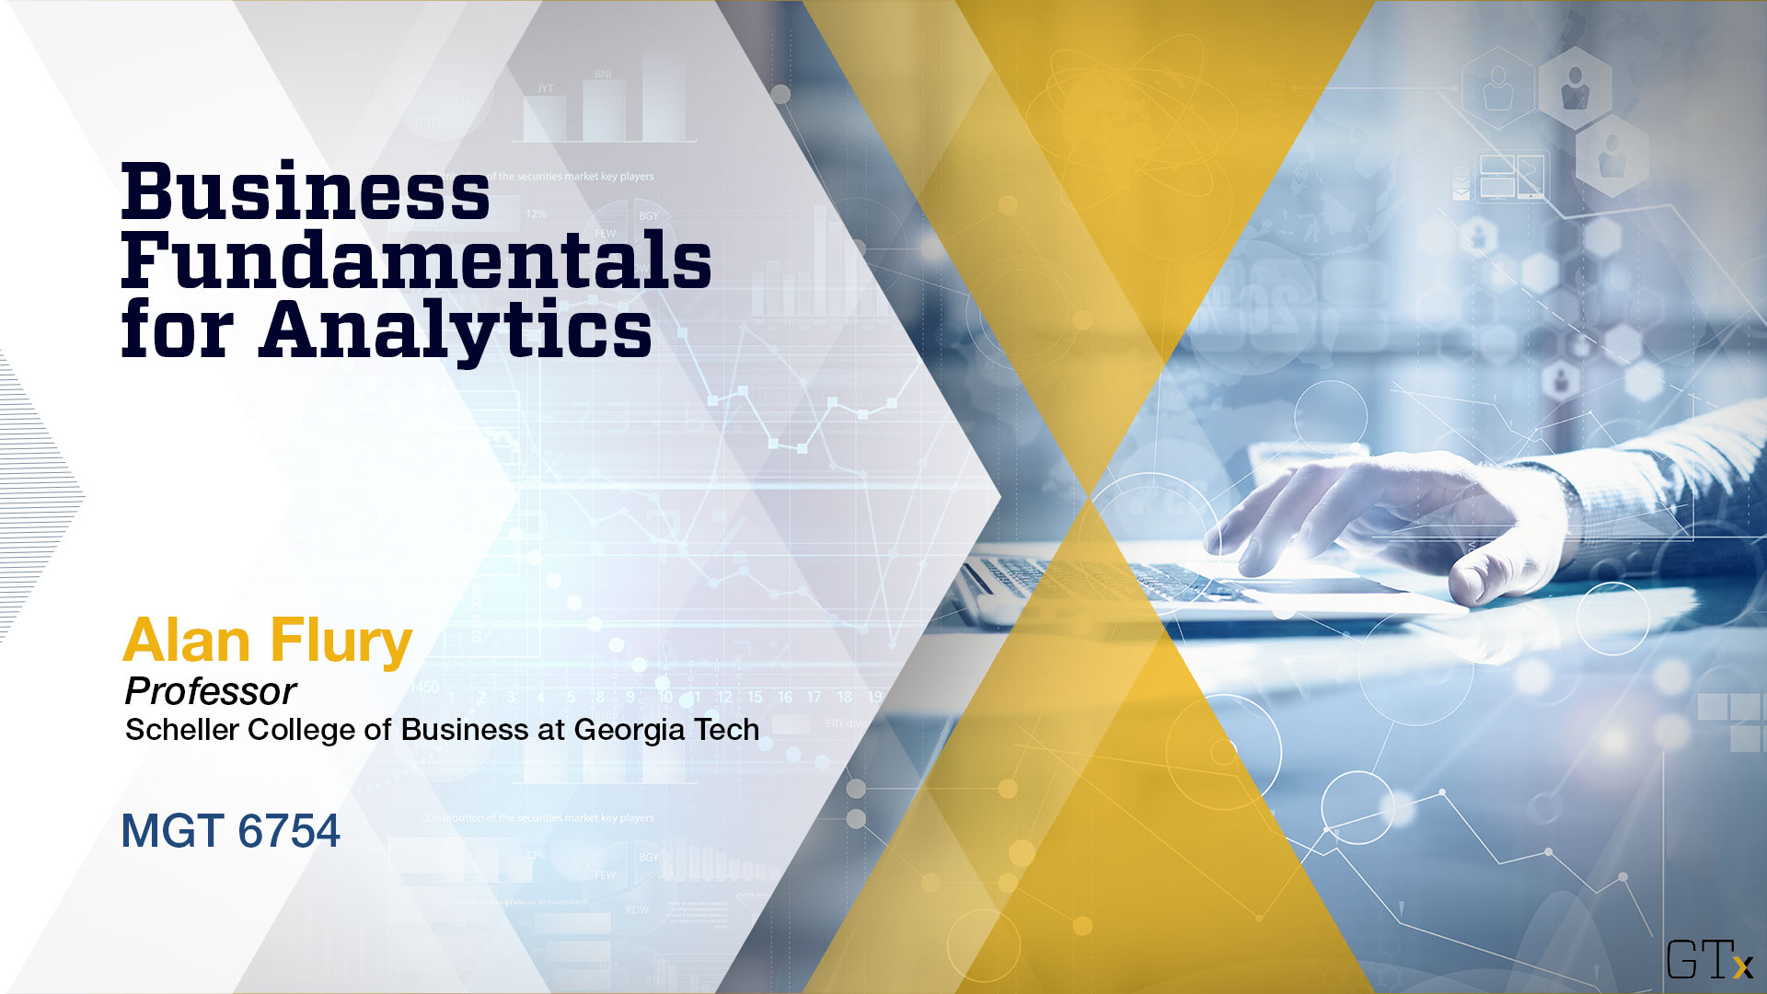
July 15 Videoconference Call
Alan Flury
Scheller College of Business

Slide 2
MGT6754 Business Fundamentals for Analytics Video Conference Call #10 Agenda
Homework Assignment #4 Review
General Discussion
Introduction to Strategy
The Strategic Management Process
Next Videoconference Call – Thursday July 18: External and Internal Analysis

Slide 3
MGT8803 Business Fundamentals for Analytics Video Conference Call #10 Homework#4 Entrepreneurial Finance
Question %correct
1 86
2 95
3 73
4 84
5 91
6 89
Average Grade = 86%
Average Grade (All Homeworks) = 89.55
Average Course Grade = 51.90 (86.5%) – 28 students have an average > 100%
Revised Grade Cutoffs =
A = 88.5
B = 77
C = 66

Slide 4
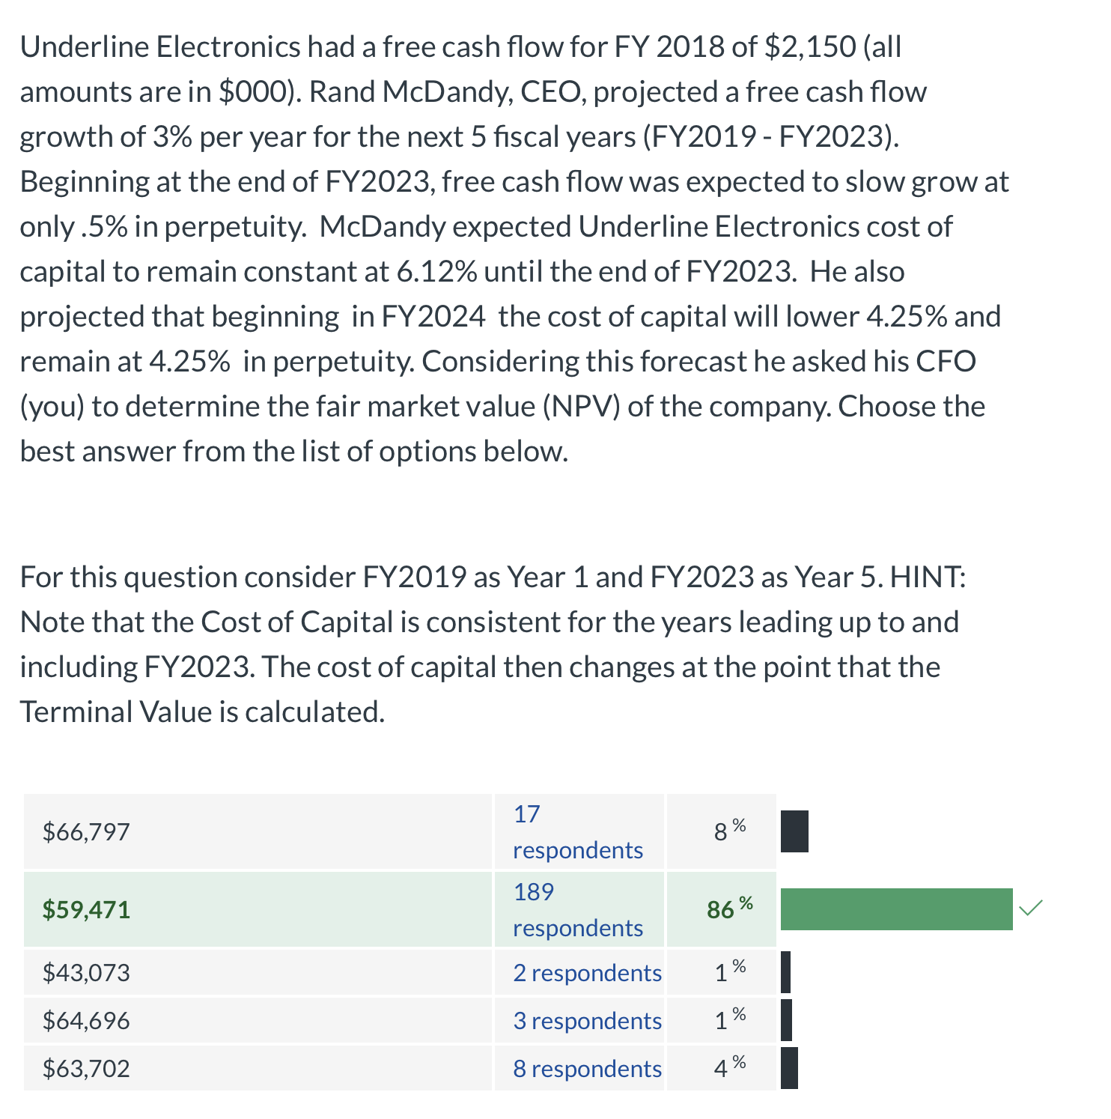
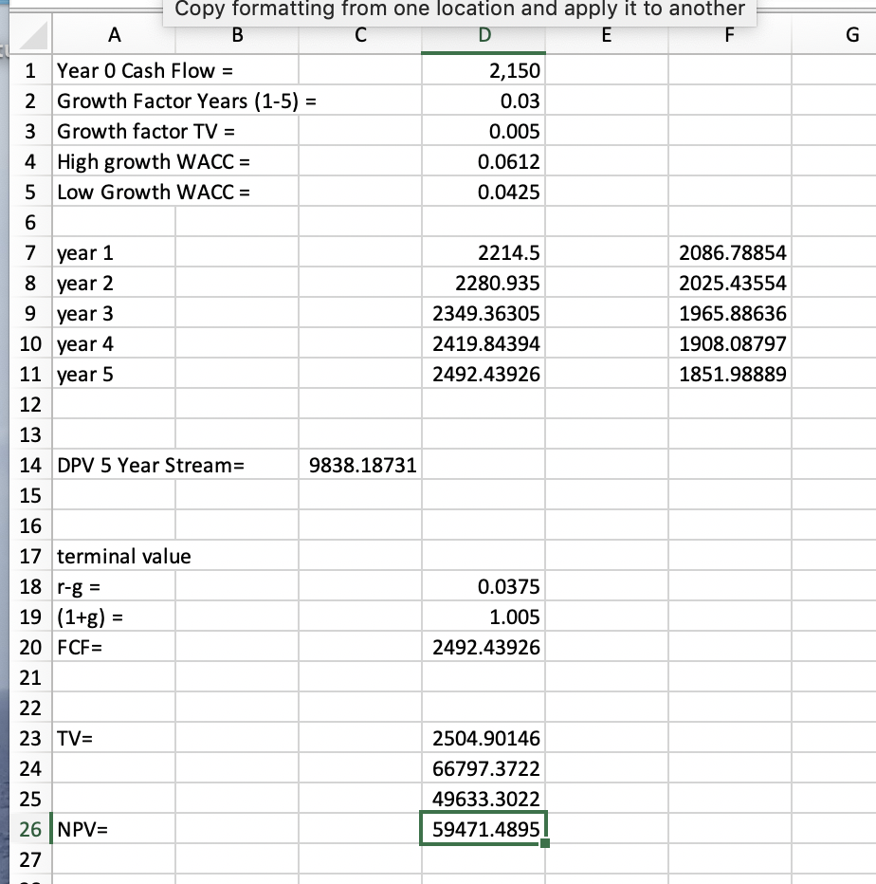
MGT6754 Business Fundamentals for Analytics Video Conference Call #10 Graded Homework #4 – Question 1

Slide 5
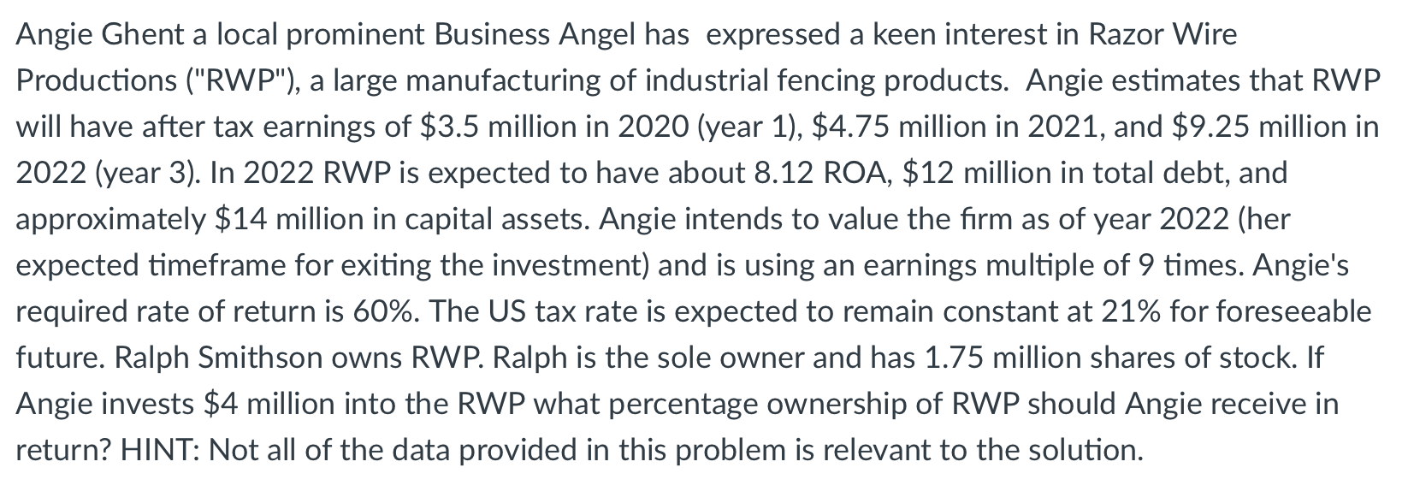
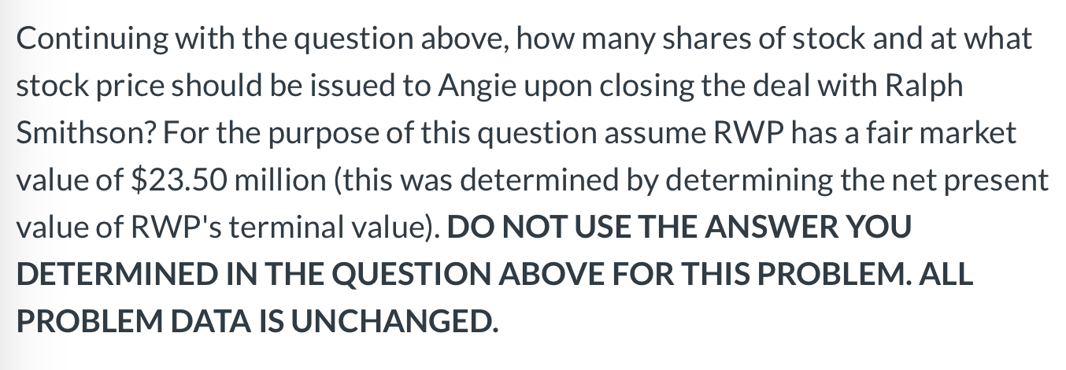
MGT8803 Business Fundamentals for Analytics Video Conference Call #10 Graded Homework #4 – Questions 2 and 3
Using the VC Method:
NPV (Razor Wire Productions) = ($9.25 * 9)/1.6^3 = $83.25/4.096 = $20.32m
Angies’ ownership % = $4/$20.32 = 19.68%
% ownership = $4/$23.50 = 17.02%
x/(x + 1.75million) = .1702
solve for x = 358,968
Price/share = $4million/358,968 = $11.14

Slide 6
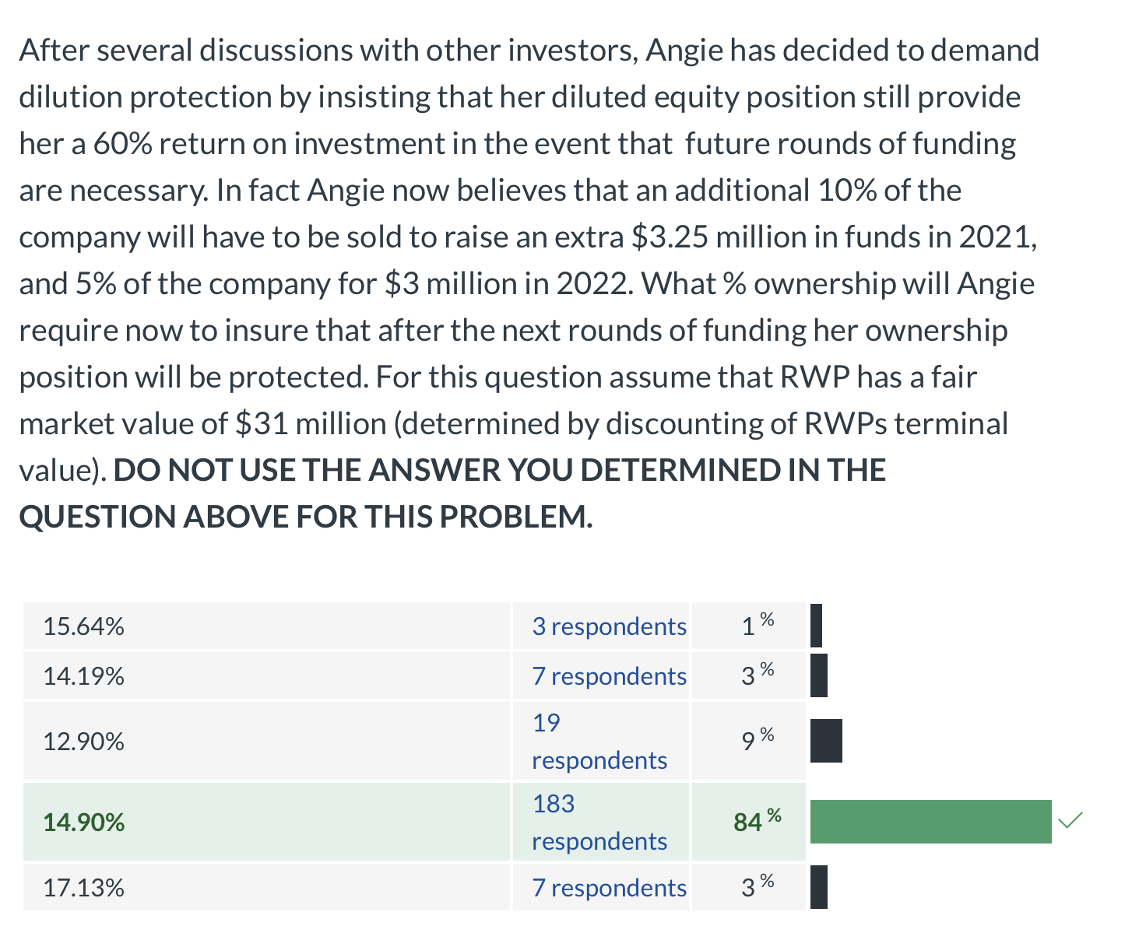
MGT8803 Business Fundamentals for Analytics Video Conference Call #11 Graded Homework #4 – Question 4
% ownership = $4/$31 = 12.90%
First round of dilution = 10%
Retention ratio = 1/(1 + .1) = .909
Antidilution (first round) = 12.90/.909 = 14.19%
Second round of dilution = 5%
Retention ratio = 1/(1+ .05) = .9524
Antidilution (second round) = 14.19/.9524 = 14.90%

Slide 7
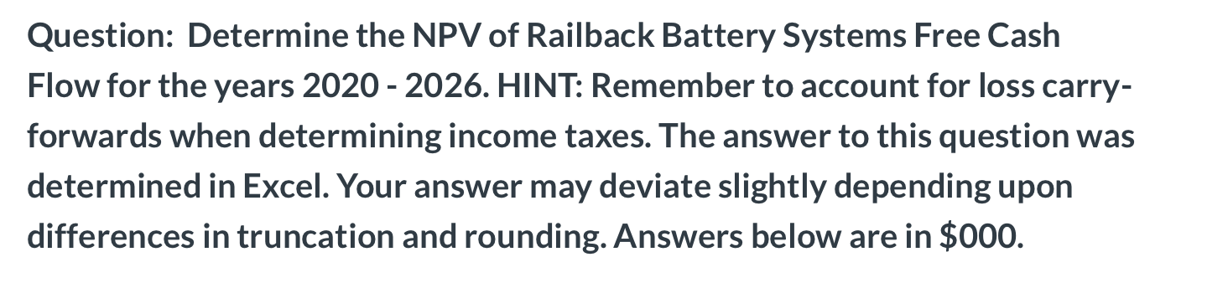
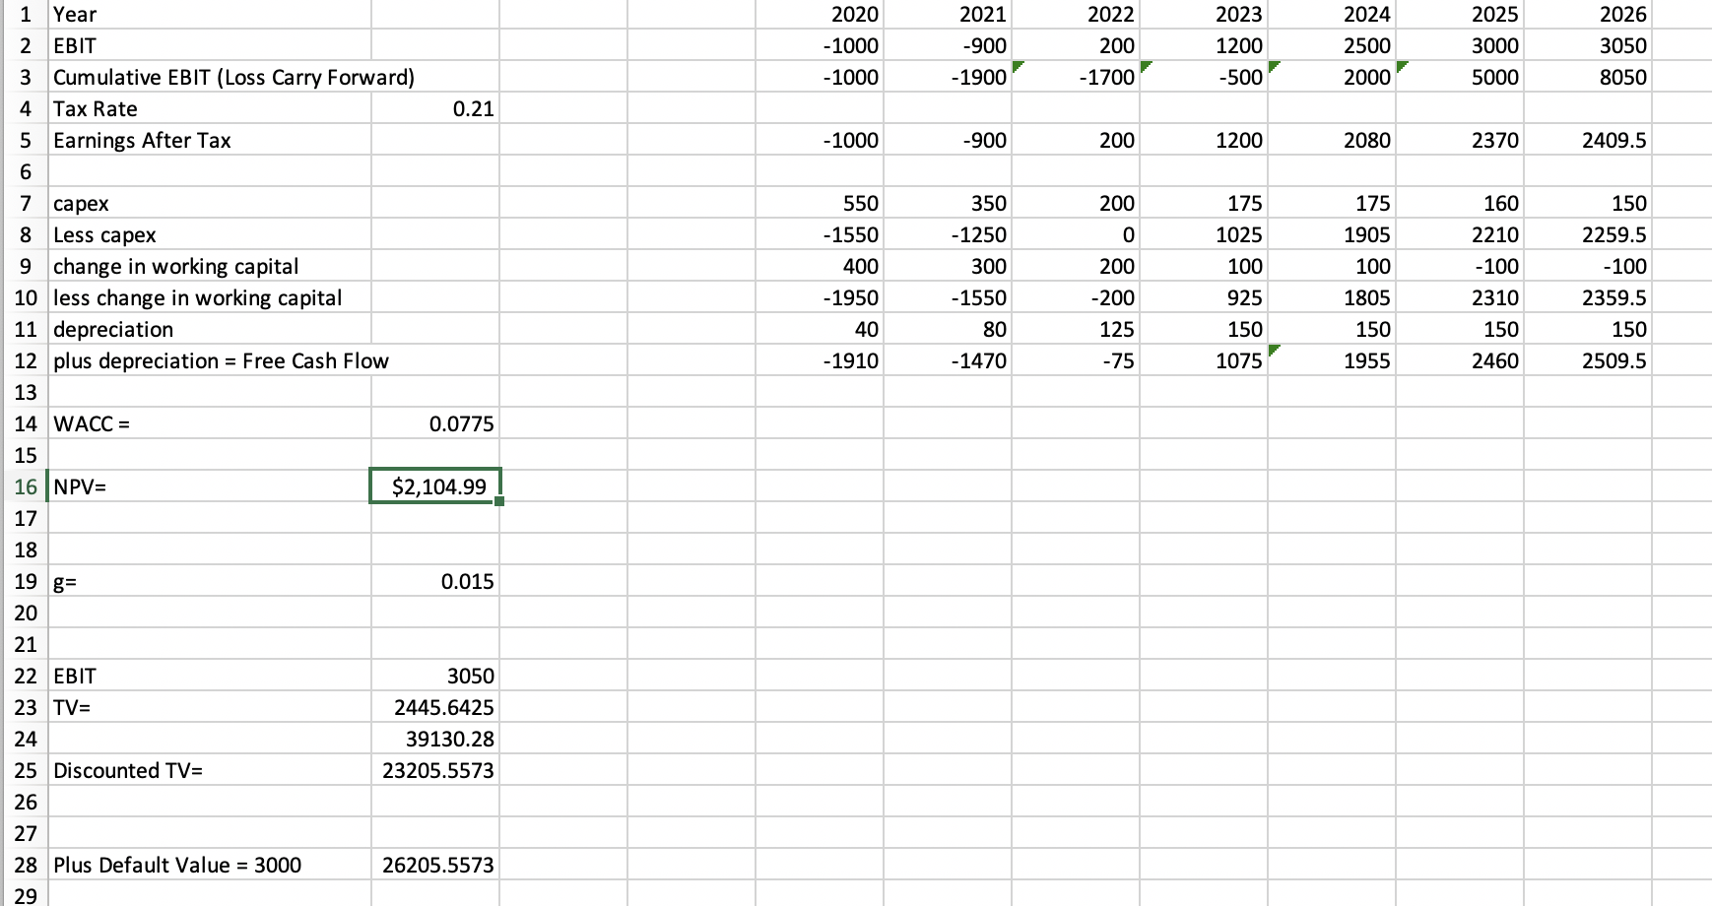
MGT8803Business Fundamentals for Analytics Video Conference Call #10 Graded Homework #4 – Questions 5 and 6
FCF = (EBIT*(1-t)) - Capex – Change in WC + Depreciation
data provided in problem
Calculate the fair market value (NPV) for Railback Battery Systems. For this problem assume that the Net Present Value of Railback free cash flow for the period 2020 - 2026 is $3000 (NOTE its not $3000 but make this assumption in case the answer you determined in the first question was incorrect). Assume no underlying changes to any of the data in the problem. DO NOT USE YOUR ANSWER FROM THE QUESTION ABOVE. All ANSWERS ARE IN $000
Terminal Value Calculation
TV = EBIT*(1-t)*(1+g)
TV = ((EBIT*(1-t)) - Capex – Change in WC + Depreciation)*(1+g)
r-g
Where EBIT = EBIT in year leading to the TV calculation
Capex = Depreciation; Change in WC = 0
Beginning after year 2026 the annual growth in EBIT is expected to be 1.5%, a rate that is projected to be constant over Railbacks remaining life as an enterprise. Beginning in 2026 Railback’s capital expenditures and depreciation are expected to offset each other (capex - depreciation = 0) and year to year changes in working capital are expected to be zero (working capital levels remain constant year over year). For discounting purposes consider 2020 as year 1.
Assume a tax rate is 21% and a cost of capital of 7.75%

Slide 8
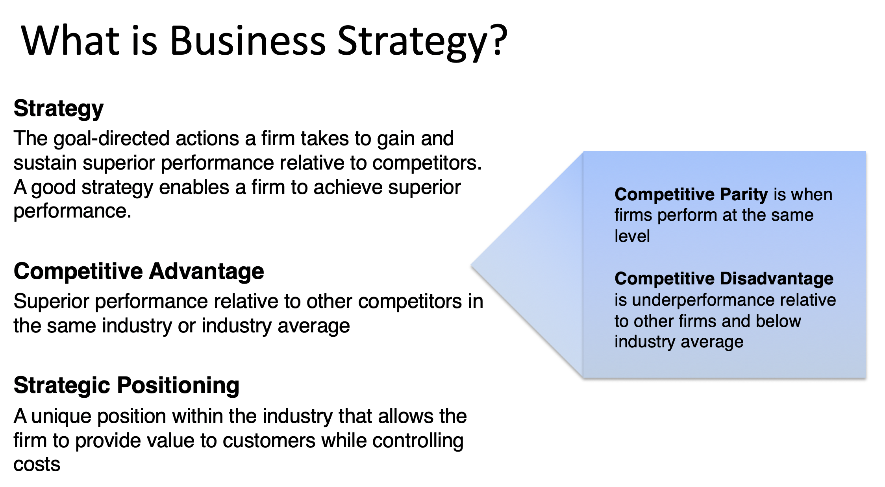
MGT8803 Business Fundamentals for Analytics Video Conference Call #10 Business Strategy – Important Concepts

Slide 9
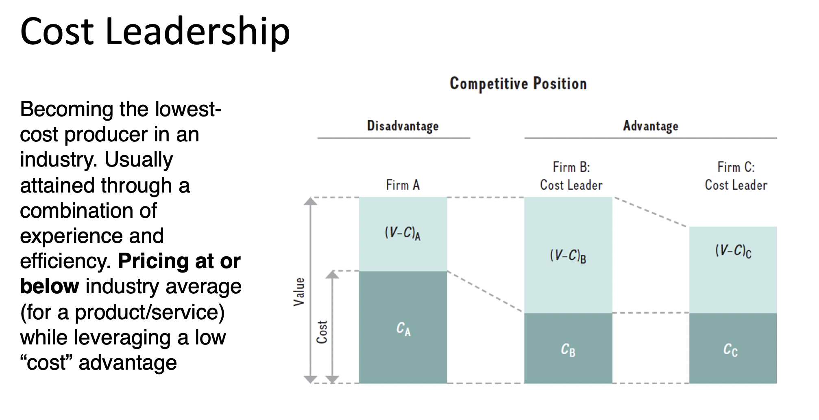
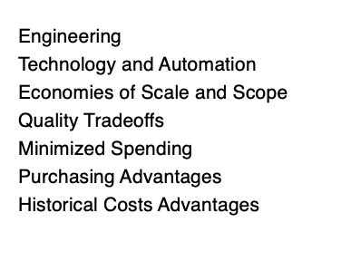
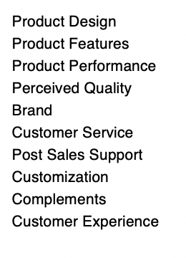
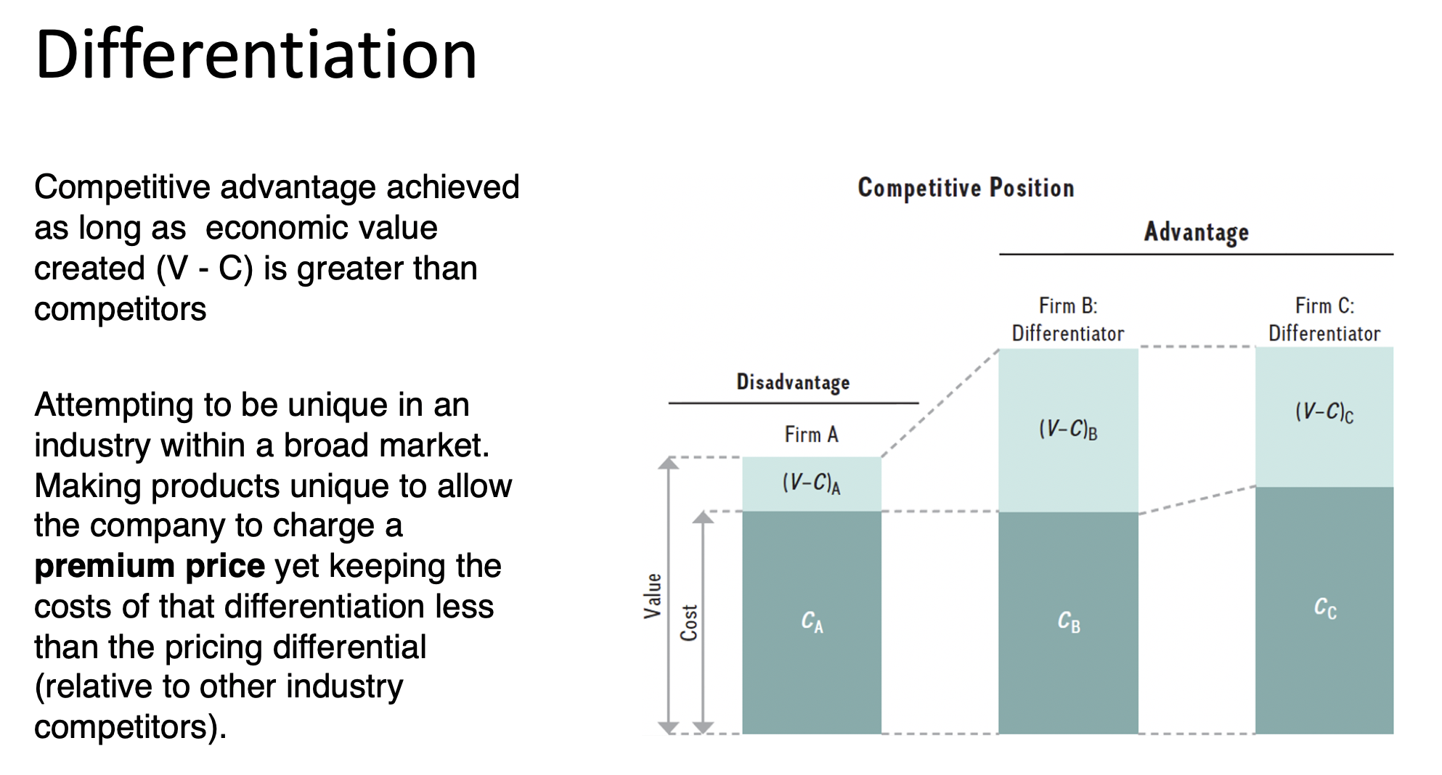
MGT8803 Business Fundamentals for Analytics Video Conference Call #10 Business Strategy and Business Models – Important Concepts

Slide 10
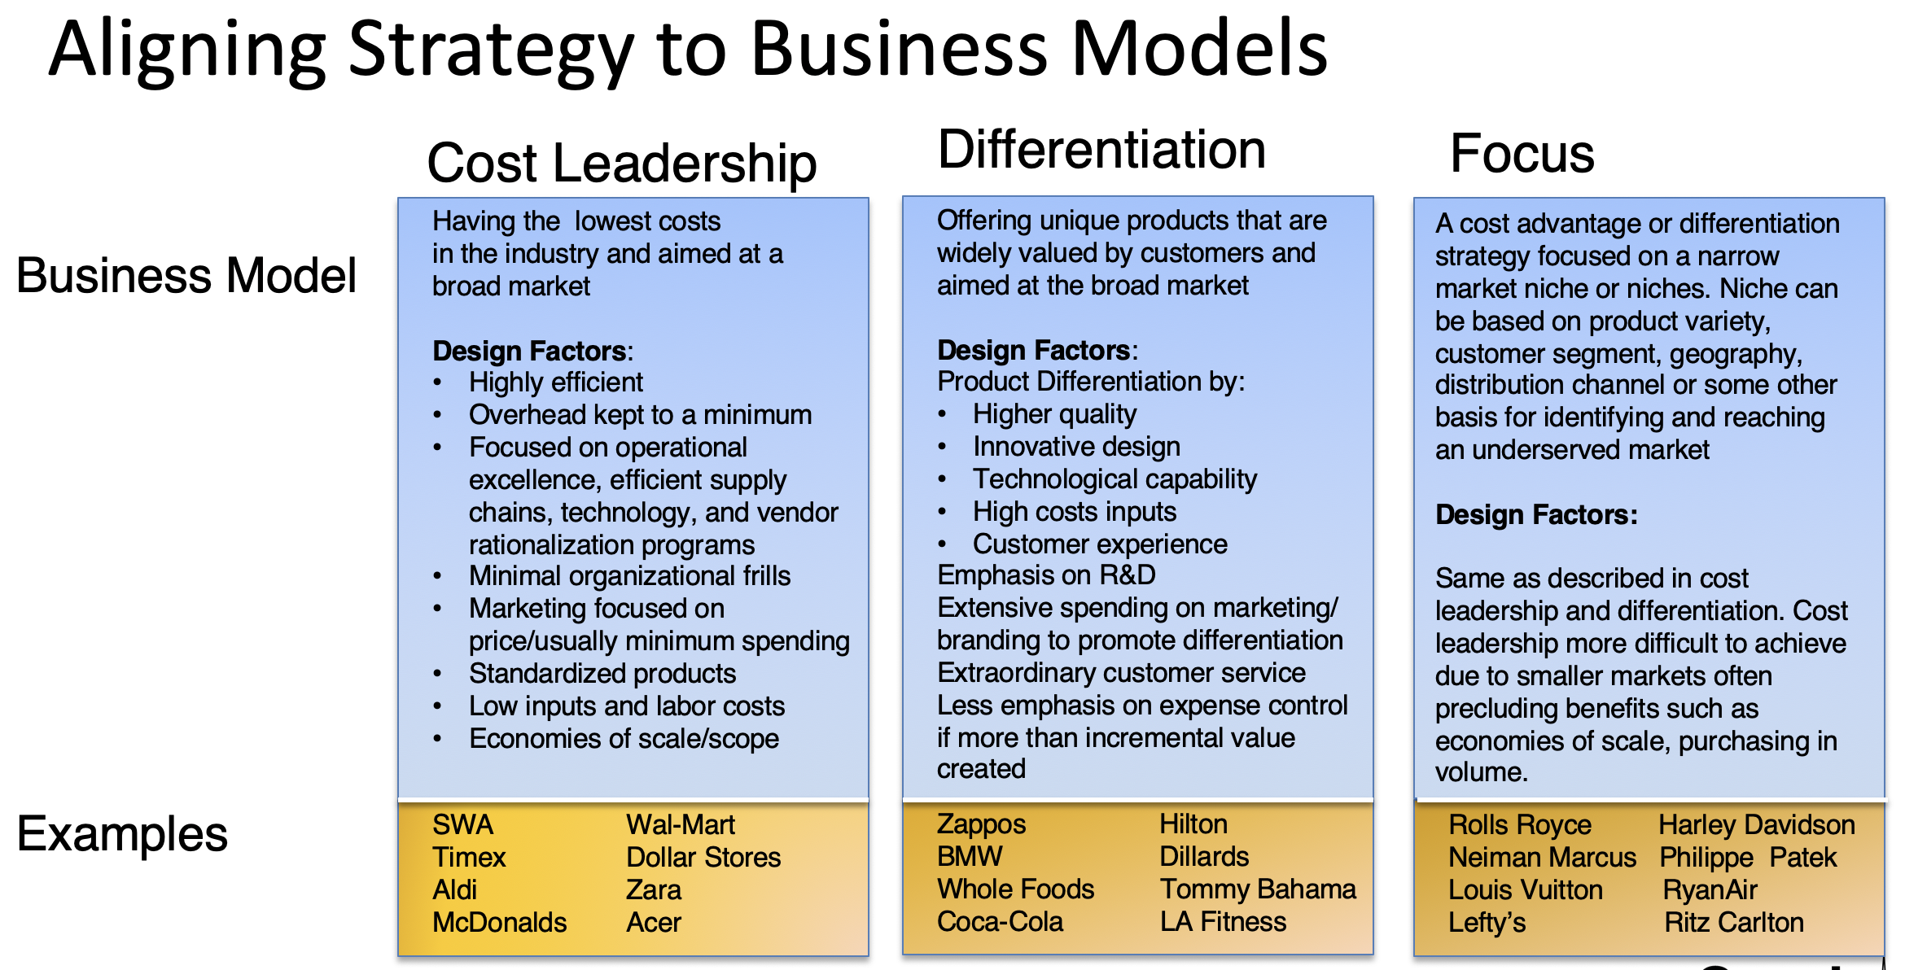
MGT8803 Business Fundamentals for Analytics Video Conference Call #10 Business Strategy and Business Models – Important Concepts

Slide 11
MGT8803 Business Fundamentals for Analytics Video Conference Call #10 Business Strategy -- Important Concepts
Strategy may be formulated on a top down or a bottom up basis. There are multiple approaches to creating and implementing strategy.
Top Down Traditional (clear enough future)
Scenario Planning (2 to 6 or more plausible futures)
Strategy as Planned Emergence (both top-down and bottom up)
Each of these approaches to developing strategy are different responses to the degree of risk in the environment AND all are based on a foundation of analysis. External Analysis focuses markets, industry, and the global environment - eventually identifying opportunities and threats that primarily impacts product/services offerings and markets. Internal Analysis focuses on strengths and weaknesses mainly related to the firms resources and capabilities.

Slide 12
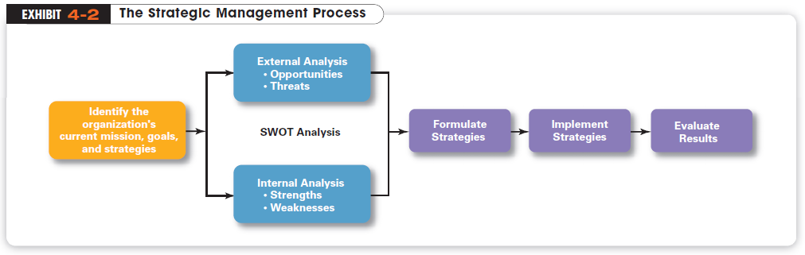
MGT8803 Business Fundamentals for Analytics Video Conference Call #10 Business Strategy Methodologies
“Formulation”
“Analysis”
“Implementation”
Notes:
A six-step process that involves strategic planning, implementation, and evaluation. Strategic planning encompasses the first four steps.
Identify the organization’s current mission, objectives, and strategies (Step 1). Every organization has a mission statement that defines its purpose and answers the question, “What business or businesses are we in?” Determining the nature of one’s business is as important for not-for-profits as it is for business firms. Once its mission has been identified, the organization can begin to look outside the company to ensure that its strategy aligns well with the environment.
Analyze the external environment (Step 2). Organizations need an accurate grasp of the environment and important trends that might affect the organization’s operations. Opportunities are positive external environmental factors. Threats are negative ones. The same environment can present opportunities to one organization and pose threats to another.
Evaluate the organization’s internal resources (Step 3). This involves asking specific questions and analyzing the available information. What skills and abilities do the organization’s employees have; human resources? What is the organization’s cash flow; financial resources? Has it been successful at developing new and innovative products? How do customers perceive the image of the organization and the quality of its products or services? Every organization is constrained in some way by available resources and skills or what the organization has? The analysis should lead to a clear assessment of the organization’s internal resources, such as capital, worker skills, patents, and the like. The capabilities include, how does the organization work? It should also indicate organizational departmental abilities, such as training and development, marketing, accounting, human resources, research and development, and management information systems.
Strengths (strategic) are internal resources or things that the organization does well (Step 3). Core competencies are any of those strengths that represent unique skills or resources that can determine the organization’s competitive edge. When an organization lacks certain resources or identifies activities the firm does not do well, these are called weaknesses. A merging of the externalities (Step 2) with the internalities (Step 3) results in an assessment of the organization’s opportunities. This merging is called SWOT analysis because it brings together the organization’s Strengths, Weaknesses, Opportunities, and Threats in order to: exploit an organization’s strengths and external opportunities, buffer or protect the organization from external threats, correct critical weaknesses.
Having completed the SWOT analysis, the organization reassesses its mission and objectives.
In STEP 4, managers formulate strategies. When formulating strategies, managers should consider the realities of the external environment and their available resources and capabilities, and then design strategies that help the organization to achieve its goals. Managers typically formulate corporate, business, and functional strategies. New goals and strategic alternatives are identified and evaluated. Alternatives can be limited by the mission and goals of the organization as well as the result of the SWOT analysis . At the corporate level this analysis also looks at the relative attractiveness of each SBU. During this process strategies are formulated at the corporate, SBU, and functional levels
STEP 5 involves implementing strategies. Once formulated, strategies must be implemented appropriately. Strategy must be converted into organization actions including 1) determining and implement a more appropriate organizational structure, 2) developing shorter range goals, and 3) establishing annual functional strategies/budgets. May include policy changes, structural changes, staffing changes, changes to training programs, and systems changes.
In STEP 6, managers evaluate results.
Strategic intelligence and decision making responsibilities are concentrated at the top of the organization, then cascade down to create a set of interdependent plans which when successfully implemented achieve the strategic plan
Long range plans are visited regularly and updated with new predictions of future growth
Planners provide careful analysis of internal and external data and apply it to all quantifiable areas – prices, costs, margins, demand, head count, etc.
Annual budgets are tied to strategic plan to help monitor ongoing performance
The energy crisis, deregulation in the marketplace, rapidly changing technology, and increasing global competition have changed the nature of planning forever.
Managers now must analyze the environment, assess organizational strengths and weaknesses, and identify opportunities for gaining competitive advantage. Then, they must develop strategic plans based on their findings.
Senior management uses the nine-step strategic management process to develop organizational strategy.

Slide 13
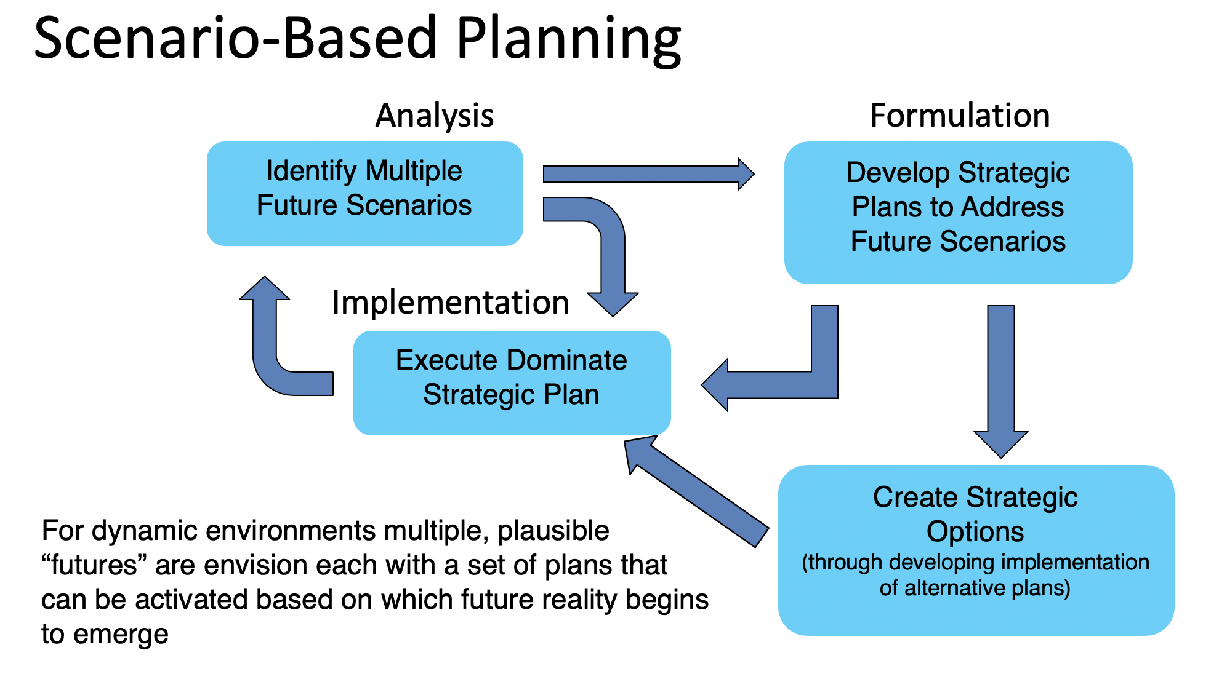
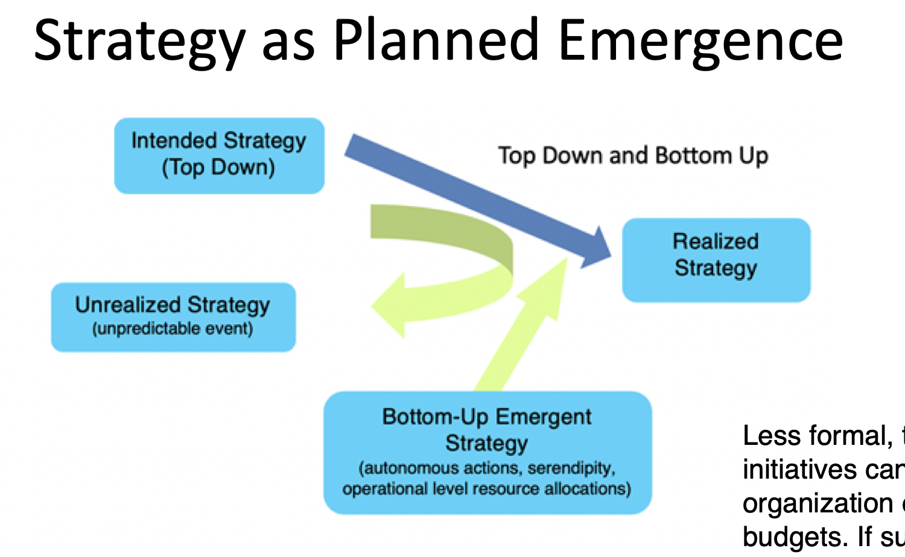
MGT8803 Business Fundamentals for Analytics Video Conference Call #10 Business Strategy Alternate Approaches

Slide 14
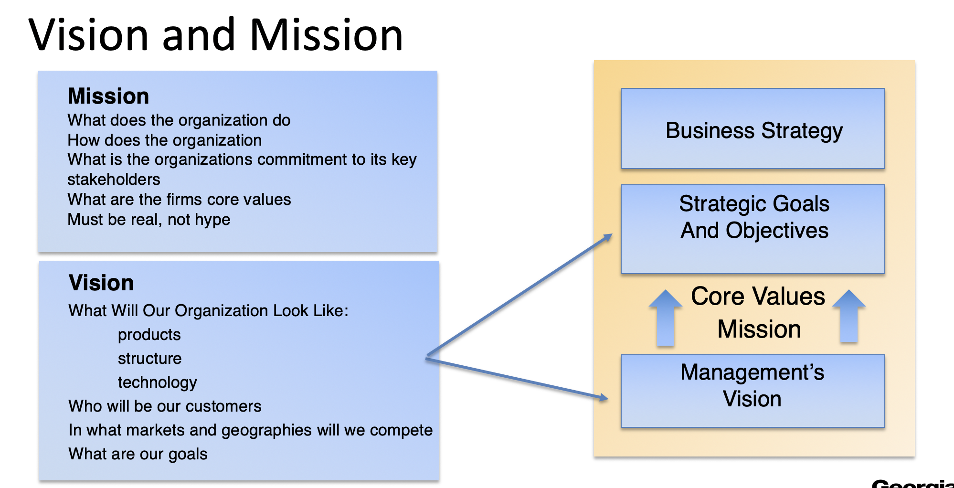
MGT8803 Business Fundamentals for Analytics Video Conference Call #10

